Slide 1
TypeScript Essentials
Getting started with TypeScript
Types available in TypeScript
TypeScript configuration

Slide 2
1. Getting Started with TypeScript
Overview
TypeScript vs. ECMAScript
Using the TypeScript compiler
What version of ECMAScript is generated?
Migrating JavaScript code to TypeScript
Aside: Using the TypeScript Playground

Slide 3
Overview
TypeScript adds static type-checking to JavaScript code
Compile your code using the TypeScript compiler
The TypeScript compiler spots type errors in your code
How this helps:
Detects misuse of variables (e.g., doing maths on a string)
Detects bad function calls (e.g., incorrect arguments)
Also:
IDEs can provide IntelliSense hints 😃
3

Slide 4
TypeScript vs. ECMAScript
TypeScript supports modern JavaScript (ECMAScript) features, plus:
Data typing
Various type operators (e.g., typeof)
Function signatures
Keywords public, private, protected
Generics
Interfaces
Decorators (similar to annotations in Java)
4

Slide 5
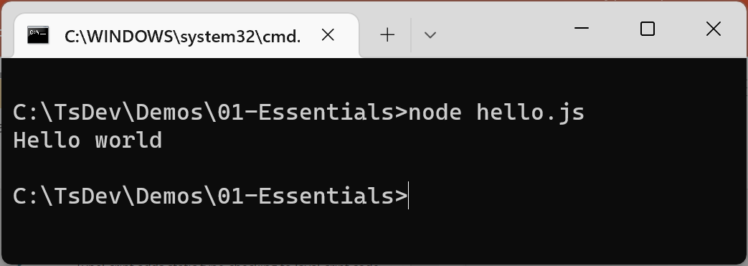
Using the TypeScript Compiler
You can install the TypeScript compiler as follows:
To compile TS code to JS, and then run it:
npm install -g typescript
let message: string;
message = 'Hello World';
tsc hello.ts
var message;
message = 'Hello world';
hello.ts
hello.js
node hello.js
5

Slide 6
What Version of ECMAScript is Generated?
By default, the TypeScript compiler generates ES3 code
This is a very old version of ECMAScript
For maximum portability
You can generate a specific version of ECMAScript, via the --target option
E.g., to generate ES2015 (aka ES6) code:
tsc --target es2015 hello.ts
6

Slide 7
Migrating JavaScript Code to TypeScript (1 of 2)
The TypeScript compiler allows you to compile existing JavaScript code
The absence of type info isn't a problem
The TypeScript compiler just doesn't do type checking
E.g., the following code compiles fine:
function func(x, y) {
return x + y;
}
var res = func(10, 20);
existingJavaScriptCode1.ts
7

Slide 8
Migrating JavaScript Code to TypeScript (2 of 2)
The TypeScript compiler can detect errors in TypeScript or even JavaScript code
E.g., the following code causes a compiler error:
Even if the TypeScript compiler detects errors, it still emits a JavaScript output file
To prevent this, use the --noEmitOnError compiler option
function func(x, y) {
return x + y;
}
var res = func(10);
existingJavaScriptCode2.ts
8

Slide 9
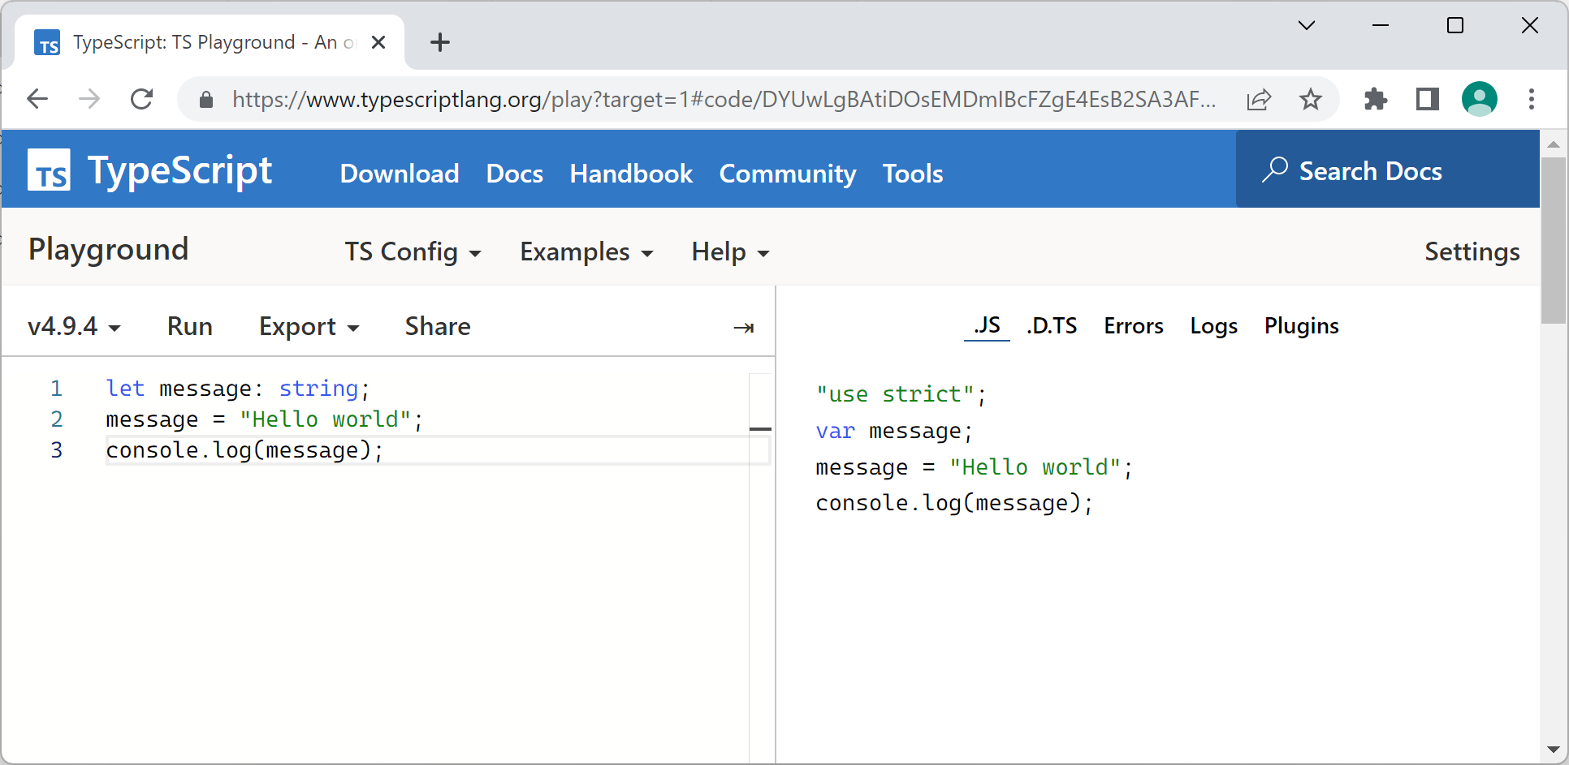
Aside: Using the TypeScript Playground
There's a handy TypeScript compiler available online, where you can practice your TypeScript skills
http://www.typescriptlang.org/play/
Choose target language via menu TS Config | Target
Then try out some TS!
9

Slide 10
2. Types Available in TypeScript
Defining types in declarations
TypeScript basic types
Arrays
Tuples
Enums

Slide 11
Defining Types in Declarations
TS allows you to define types in declarations
Variables, parameters, and function return types
Use the syntax variableName:type
Note that TS automatically inferred the type of name2
Transpiles to
let name1: string = 'Fred';
let name2 = 'Wilma';
var name1 = 'Fred';
var name2 = 'Wilma';
types.ts
types.js
11

Slide 12
TypeScript Basic Types (1 of 2)
number - a floating point or whole number
bigint - a big integer, via BigInt(xxxx)
boolean - true or false
string - literal text or template string `${x}`
symbol - a symbol, via Symbol('nnnn')
function - a function
12

Slide 13
TypeScript Basic Types (2 of 2)
object - non-primitive type (e.g., object, array)
void - no type (e.g., function with no return)
never - function that never returns normally
null - data type of null value
undefined - data type of undefined value
any - disables type-checks, e.g., legacy code
13

Slide 14
Arrays
TS supports arrays
Use the type of the elements followed by []
Or use the generic array type Array<elemType>
let a = [1,2];
let b: Array<number> = [3,4];
Transpiles to
var a = [1,2];
var b = [3,4];
arrays.ts
arrays.js
14

Slide 15
Tuples
TS supports tuples
Effectively an array of mixed types
let bd: [number, string];
bd = [3, 'December'];
let day: number = bd[0];
let month: string = bd[1];
var bd;
bd = [3, 'December'];
var day = bd[0];
var month = bd[1];
Transpiles to
tuples.js
tuples.ts
15

Slide 16
Enums
TS supports enums, to represent a fixed set of states
Enum mnemonics can be strings
enum Color {R=1, G, B};
let c: Color = Color.R;
Transpiles to
var Color;
(function (Color) {
Color[Color['R'] = 1] = 'R';
Color[Color['G'] = 2] = 'G';
Color[Color['B'] = 3] = 'B';
})(Color || (Color = {}));
var c = Color.R;
enums.ts
ES5 code
enums.js
enum Color {R='coch', G='gwyrdd', B='glas'};
16

Slide 17
3. TypeScript Configuration
Strictness checks
Aside: Permitting null or undefined values
Providing a tsconfig.json file

Slide 18
Strictness Checks (1 of 2)
By default, TypeScript is not very strict
It assumes untyped variables are any
It lets you set variables to null or undefined
E.g., the following code compiles fine:
function func(arg) {
console.log(`func received ${arg}`);
}
func(42);
let name1: string = null;
console.log(name1.toLowerCase());
let name2: string = undefined;
console.log(name2.toLowerCase());
strictness.ts
18

Slide 19
Strictness Checks (2 of 2)
For full strictness checks, use the --strict option:
Alternatively, you can enable specific strictness checks. For example:
tsc --strict strictness.ts
To prevent implicit use of any:
tsc --noImplicitAny strictness.ts
To prevent variables accidentally being null or undefined:
tsc --strictNullChecks strictness.ts
19

Slide 20
Aside: Permitting null or undefined Values
If you do want to allow a variable to be possibly null or undefined, you can declare a union type as follows:
// city can be a string or null.
let city: string | null;
city = null;
city = 'Swansea';
// country can be a string or undefined.
let country: string | undefined;
country = undefined;
country = 'Wales';
// postcode can be a string or null or undefined.
let postcode: string | null | undefined;
postcode = null;
postcode = undefined;
postcode = 'SA3 5BR';
permitNullOrUndefined.ts
20

Slide 21
Providing a tsconfig.json File (1 of 2)
You can provide a tsconfig.json file to configure compiler options for a bunch of files in a project
In tsconfig.json:
Specify the files you want to include/exclude in the project
Specify compiler options etc.
Run tsc without any filenames at the command line
Compiles files as specified in tsconfig.json
tsc
21

Slide 22
Providing a tsconfig.json File (2 of 2)
For an example of tsconfig.json, see demo-app
Simple React project, written in TypeScript
Take a look at the tsconfig.json file
To install Node.js libraries, and then run the application:
For full details about tsconfig.json options, see:
https://www.typescriptlang.org/tsconfig
npm install
npm start
22

Slide 23
Summary
Getting started with TypeScript
Types available in TypeScript
TypeScript configuration

